Slide 1

APAS Chatbot
Tony Ma

Slide 2

LLMs
A family of LLMs like GPT-3,4 ,PaLM 2 and Llama 2
Developed and Work in essentially the same way
Use same transformer architecture and development ideas
The words(“Apple” and “IPhone”) consistently appear together=>two concepts are related.

Slide 3

Llama 2
Llama2[2] ‘s level like GPT-2
Chatgpt size is 280B hidden parameters and Llama2 only 7B/13B/13B hidden parameters
Being so open with Llama
You can download the model
You are able to run on your computer/cell phone

Slide 4

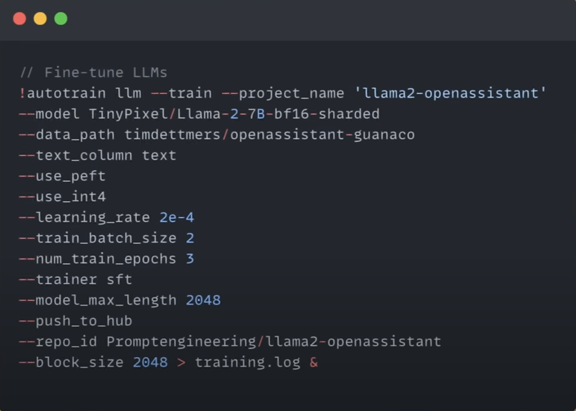
Llama 2 fine tuning, but it is not free on Hugging Face

Slide 5

Quantizated Llm2 Model[3]
Model Quantization is a technique used to reduce the size of large neural networks, including large language models (LLMs) by modifying the precision of their weights.
It’s possible to use significantly lower precision(float16 for example) reducing the overall size of the model. [4]

Slide 6

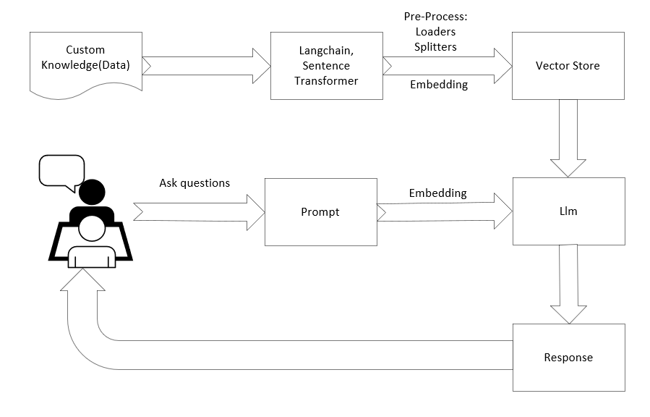
High Level Diagram
Add custom knowledge (data)
Langchain does the Pre-Process Loaders Splitters
Sentence Transformer Embedding
Vector Store Inbuilt similarity algorithm
Prompt User input query Response (result)

Slide 7

First Lesson Summary
Support multiple language Custom knowledge:
English-French dictionary
APAS knowledge
Some questions’ issues Some questions’ answers are not satisfied
Performance Sometimes it is slow
Here is what we learned

Slide 8
Reference
[1] Harry Guinness Aug 16,2023 What is Llama 2 and why does it matter? https://zapier.com/blog/llama-meta/
[2] autotrain Hugging Face https://huggingface.co/autotrain
[3] Miguel Carreira Neves What are Quantized LLMs? https://www.tensorops.ai/post/what-are-quantized-llms
[4] Bloke Quantized one llama-2-7b-chat.ggmlv3.q8_0.bin
[5] AI Anytime Build and Run a Medical Chatbot using https://www.youtube.com/watch?v=kXuHxI5ZcG0&t=3151s Llama 2 on CPU Machine: All Open Source

Slide 9

Thank You!

